Slide 1


Classification of Human Posture from Radar Returns Using Ultra-Wideband Radar
Zachary Baird Sreeraman Rajan Miodrag Bolic (mbolic@uOttawa.ca)

Slide 2
Objective
To classify the posture of subjects using radar return signals.
Postures include:
Standing
Sitting
Lying down

Slide 3
Why radar?
Radar is non-contact and non-obtrusive
Radar emits low power and is safe for long term monitoring
Radar is capable of penetrating solid obstacles including furniture and walls
Radar preserves privacy unlike video
Applications
  Medical and homecare monitoring applications
  Military applications
  Rescue operations

Slide 4
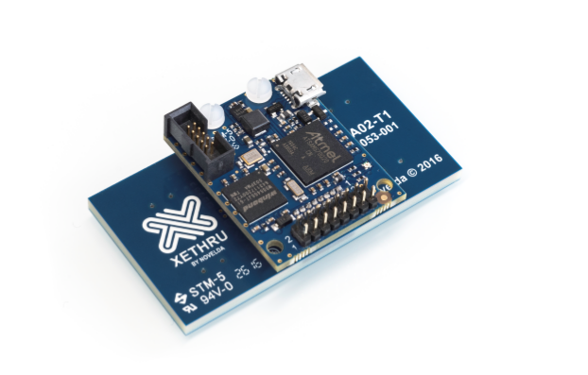
Radar used in this experiment
Novelda Xethru X4M03 (Oslo)
Ultra-Wideband
5.9-10.3 GHz bandwidth
65 degree patch antenna for Tx and Rx
10 m range
5.35 cm range resolution
17 Samples/ second sampling rate
Price $399

Slide 5
Experimental Procedure
University of Ottawa Research Ethics Board approval
Room measured 12.6 x 4.1 m
Radar at one end of room, 1.5 m above floor level
Data collected for:
  5 male subjects age 18-28
  At 3 m, 4.5 m and 6 m from radar
  Standing, sitting in a rigid back chair, lying in supine position with left lateral side facing radar (1 minute each)
  45 minutes of data in total

Slide 6
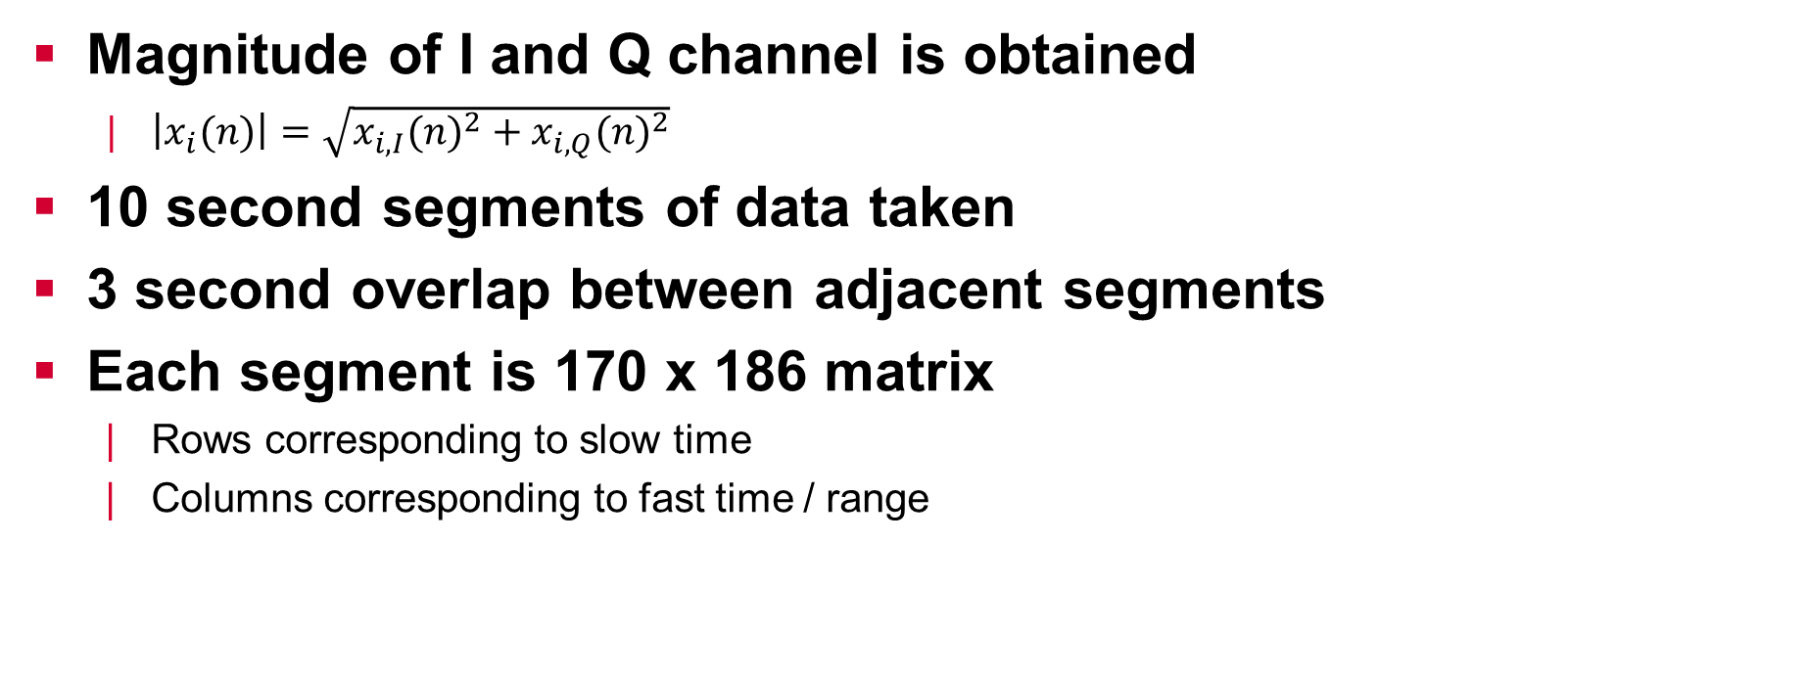
Data segmentation
Magnitude of I and Q channel is obtained
  $\left|x_{i}(n)\right|=\sqrt{{x_{i,I}(n)}^{2}+{x_{i,Q}(n)}^{2}}$
10 second segments of data taken
3 second overlap between adjacent segments
Each segment is 170 x 186 matrix
  Rows corresponding to slow time
  Columns corresponding to fast time / range

Slide 7
Feature Extraction
33 Features extracted from three domains:
  Spatial domain
  Time Domain
  Frequency Domain
Spatial Domain refers to first principal component (PC) computed along column space
  The first principal component represents the largest moving target since it is the basis vector in the direction of the largest variance in the data
  Each element in PC vector represents a point in space rather than point in time

Slide 8
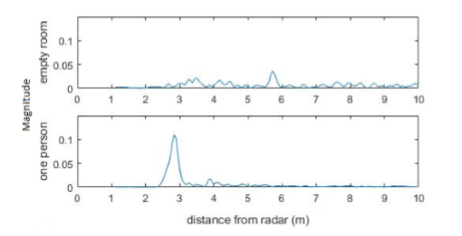
Example PC
Difference between first PC of data matrix collected from empty room vs data collected when subject is standing 3 m in front of radar

Slide 9
Spatial domain features
Window is constructed around peak in PC vector, bounded by 5% peak amplitude
Following features were extracted:
  Width of window
  Mean of window
  Median of window
  Skewness of window
  Kurtosis of window
  Entropy of window
  The ratio of the first eigenvalue to the second through ninth eigenvalue are taken as 8 additional features

Slide 10
Time domain features
Energy of the entire data matrix taken as a feature
Column of data matrix containing largest energy is assumed to be the reflected signal from the human target
Following features were extracted:
  Mean value
  RMS value
  Zero Crossing Rate
  Turns Count
  Variance
  Skewness
  Kurtosis
  Mobility
  Form factor

Slide 11
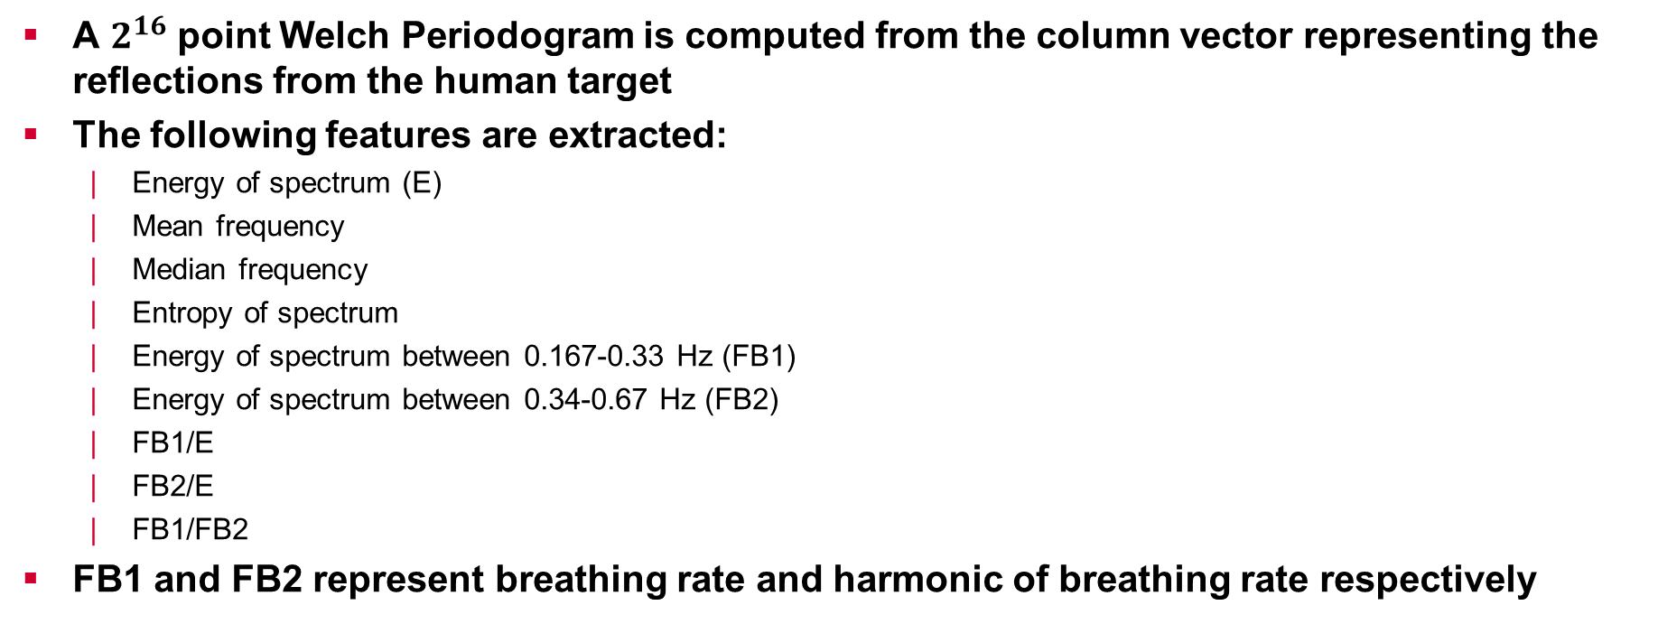
Frequency domain features
A $2^{16}$ point Welch Periodogram is computed from the column vector representing the reflections from the human target
The following features are extracted:
  Energy of spectrum (E)
  Mean frequency
  Median frequency
  Entropy of spectrum
  Energy of spectrum between 0.167-0.33 Hz (FB1)
  Energy of spectrum between 0.34-0.67 Hz (FB2)
  FB1/E
  FB2/E
  FB1/FB2
FB1 and FB2 represent breathing rate and harmonic of breathing rate respectively

Slide 12
Classification
4 different classifiers tested
  KNN
  Decision Tree
  Naive Bayes
  Linear Discriminant
70% class balanced stratified partitioning
200 randomized tests

Slide 13
Initial Results
Initially classifiers are trained on entire data set (i.e. all locations)
Overall average accuracy was only 73.85%
Spearman rank-order correlation was computed to analyze correlation between location in room and feature value
Most features showed strong correlation to location in room, indicating location variance.

Slide 14
Location specific classifier results
The same 4 classifier types trained and tested on data from each of the 3 locations within the room
Best performing classifier was decision tree for all three locations.
Overall average accuracy is increased to 84.94%
Class accuracies are
  79.07% for sitting
  92.51% for standing
  83.26% for lying.

Slide 15
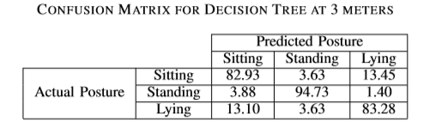
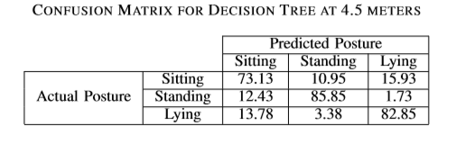
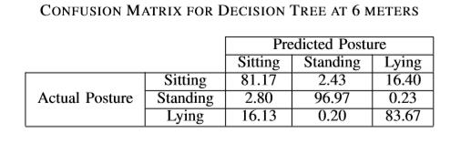
Confusion Matrices

Slide 16
Comparison to other work
Kiasari et al. presented posture classification using radar
40 spatial domain features extracted by Kiasari et al. were tested on this data for comparison of features only
  Mean, variance, skewness and kurtosis of first 10 PC vectors
Using only spatial domain features, average class accuracies were only 49.77%, 80.73% and 72.98%
This shows that spatial domain features alone are not strong enough for classifying posture

Slide 17
Discussion
When classifiers were trained on location specific data, overall average accuracy was boosted by 11%
This indicates a need for either large amounts of training data recorded at many different distances from the radar or more robust, location invariant features

Slide 18
Conclusion
Posture information in home wellness monitoring could be used to aid in fall identification and fall prevention
Posture classification was performed on radar data recorded during experiments with 5 subjects
Classifiers were trained and tested on location specific data
Decision tree classifiers performed with 85% overall accuracy
Features presented in this work were compared to features presented in a prior work, and were shown to outperform using basic classifier models

Slide 19
Limitations and Future Works
Limited to only 5 subjects
Limited in the number of subject orientations
More comprehensive data set for future algorithm development
Distance invariant features should be identified
Implementation in real time

